Slide 1

Deloitte Pre Hire Training 2017
FOUNDATION TRAINING
ORM With Hibernate

Slide 2
ORM with Hibernate 3.5
Hibernate with Annotations

Slide 3
Objectives
Creating application with Annotations
Creating application with association mapping

Slide 4
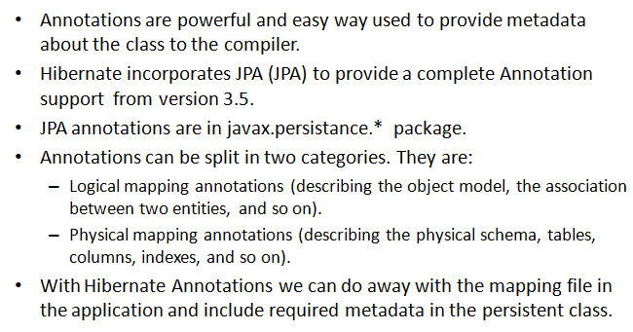
Revisiting Annotations

Slide 5
Hibernate - Annotations
@Entity Annotation
We used the @Entity annotation to the POJO class, which marks this class as an entity bean.
@Table Annotation
The @Table annotation allows you to specify the details of the table that will be used to persist the entity in the database.
@Id Annotations
Each entity bean will have a primary key, which you annotate on the class with the @Id annotation.

Slide 6
Hibernate - Annotations
@GeneratedValue
the @Id annotation will automatically determine the most appropriate primary key generation strategy to be used but you can override this by applying the @GeneratedValue annotation, which takes two parameters strategy and generator
@Column Annotation
@Column annotation is used to specify the details of the column to which a field or property will be mapped

Slide 7
Demo
Write sample code explaining Hibernate Association

Slide 8
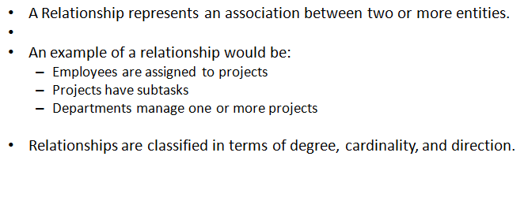
Mapping Association

Slide 9
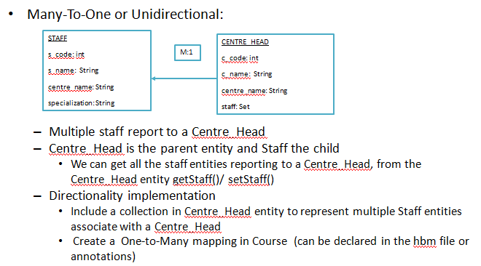
Manny-to-One Association

Slide 10
Demo
Write sample code explaining many-to-one association mapping using annotation

Slide 11
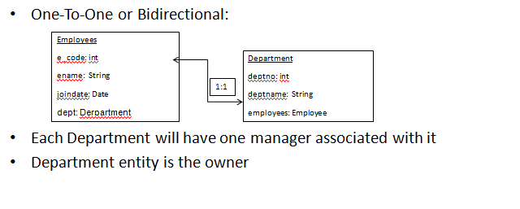
One-to-One Association

Slide 12
Demo
Write sample code explaining one-to-one association mapping using annotation

Slide 13
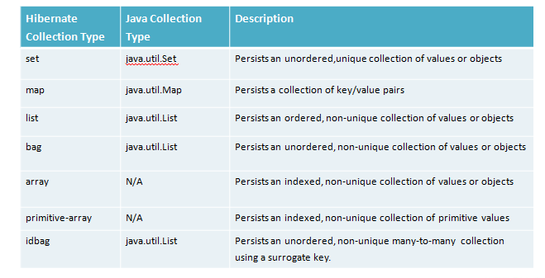
Collections in Hibernate

Slide 14
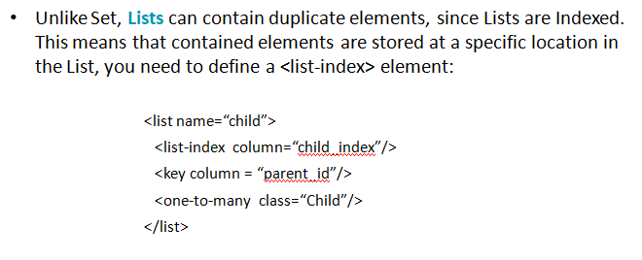
Lists

Slide 15
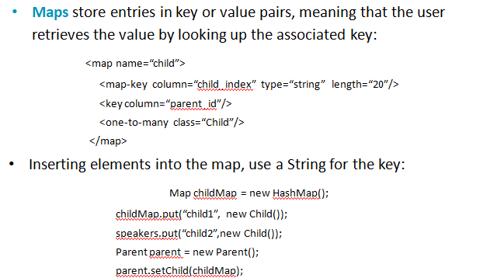
Maps

Slide 16
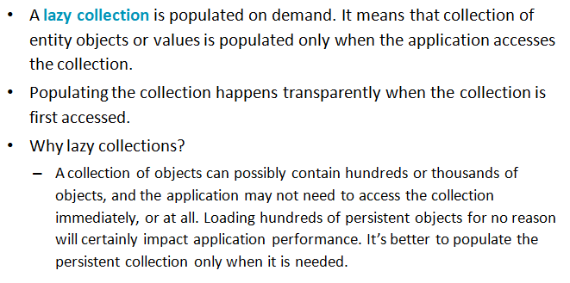
Lazy Collections

Slide 17
Demo
Write sample code explaining List, Set and Map type collection mapping using annotation

